Slide 1

/
Marketing Experiment Analysis for a Fast-Food Chain
A/B Testing
Submitted by:- Lopamudra Mohapatra

Slide 2
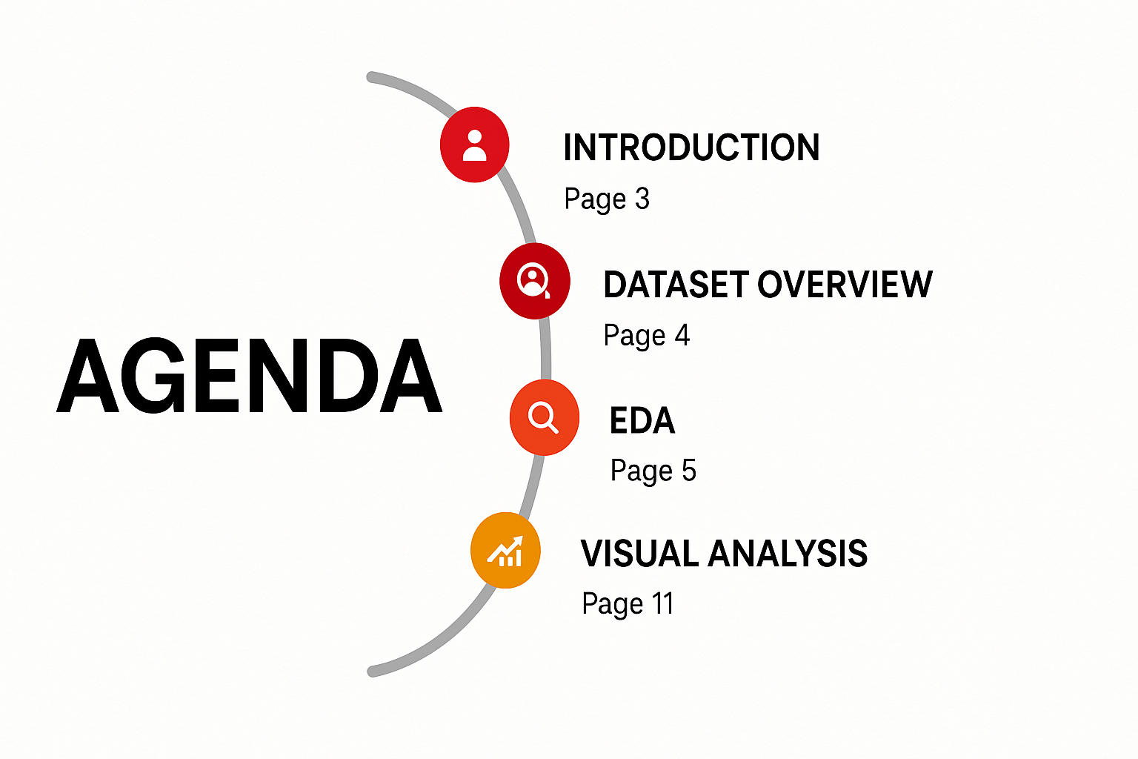

Slide 3
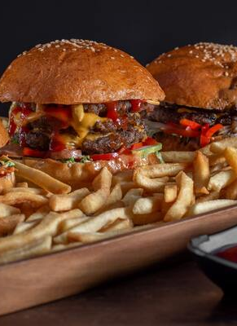
INTRODUCTION
This study analyzes a marketing experiment conducted by a fast-food chain.
Objective: To determine the most effective promotional campaign for Sale
Data includes:
Weekly sales figures across multiple locations.
Stores assigned to one of three marketing campaigns (1, 2, or 3).
Different market sizes and store ages.
Data spans over four weeks.

Slide 4
Dataset Overview
Variables in the dataset:
MarketID: unique identifier for market
MarketSize: size of market area by sales
LocationID: unique identifier for store location
AgeOfStore: age of store in years
Promotion: one of three promotions that were tested
week: one of four weeks when the promotions were run
SalesInThousands: sales amount for a specific LocationID, Promotion, and week.
The goal is to determine the effect of promotions and market characteristics on sales.

Slide 5
Sales Distribution by Store Age and Promotion
Graph Interpretation:
X-axis: Store Age Groups (divided into four bins).
Y-axis: Sales (in thousands).
Each box represents the distribution of sales for a particular store age group and promotion type (1, 2, 3).
Key Observations:
Younger Stores (0.97 - 7.75 years)
Promotion 3 has the highest sales variation, with many outliers.
Promotion 1 shows a relatively stable median, making it a safer choice.
Mid-aged Stores (7.75 - 14.5 years)
Promotion 1 and 3 have similar median sales, but promotion 3 has fewer outliers.
Promotion 2 has the lowest median sales.
Older Stores (14.5 - 21.25 years)
Promotion 3 outperforms the others, with the highest median sales.
Promotion 2 again has the lowest median sales.

Slide 6
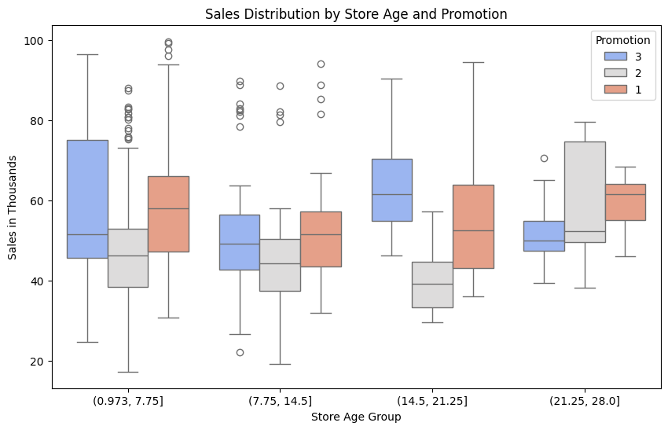
4.Mature Stores (21.25 - 28 years)
Promotion 1 has the highest median sales.
Promotion 3 has a more consistent performance.
Promotion 2 remains the weakest performer.
Business Implications:
Younger stores benefit more from Promotion 1 or 3.
Older stores see higher median sales with Promotion 1.
Promotion 2 is the least effective across all store age groups.
Promotion 3 is suitable for stores in the middle age range (7.75 - 21.25 years) due to stable performance.

Slide 7
Sales Distribution by Market Size & Promotion
Graph Interpretation:
The x-axis represents different market sizes (small, medium, large).
The y-axis represents sales (in thousands).
Each box plot represents sales distribution for a specific promotion (1, 2, 3) within each market size.
Key Observations:
Small Market Size
Promotion 3 has the highest median sales.
Sales are less variable, suggesting stable performance.
Medium Market Size
Promotions 1 & 3 have similar median sales.
Promotion 2 shows more variation, with some lower sales outliers.
Large Market Size
Promotion 1 has the highest sales potential, but also high variance.
Promotion 2 has lower median sales but a wide range.
Promotion 3 shows consistent sales performance.

Slide 8
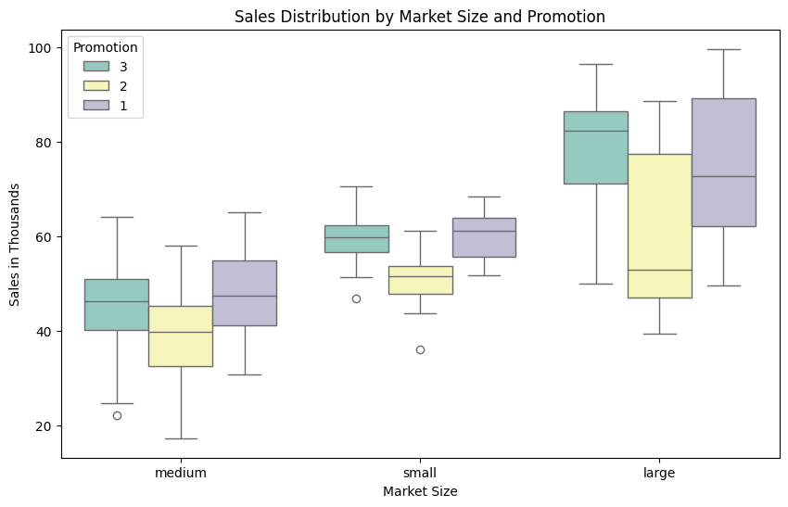
Business Implications:
For small markets: Promotion 3 performs best, making it a strong choice.
For medium markets: Promotion 1 or 3 could be preferred, but promotion 2 is less stable.
For large markets: Promotion 1 has the highest sales but is risky, while promotion 3 is more stable.

Slide 9
Sales Distribution by Promotion Type
Graph Interpretation:
X-axis: Promotion Type (1, 2, and 3).
Y-axis: Sales (in thousands).
The box plot displays the median, interquartile range (IQR), and outliers for each promotion type.
Key Observations:
Promotion 1 (Blue Box)
Highest median sales compared to the other two promotions.
Wide spread, indicating greater variability in sales.
More outliers in the higher sales range, suggesting some stores perform exceptionally well.
Promotion 3 (Green Box)
Median sales are slightly lower than Promotion 1 but still strong.
The sales distribution is more balanced, with a moderate spread.
Fewer outliers compared to Promotion 1.
Promotion 2 (Orange Box)
Lowest median sales among the three promotions.
The sales spread is tighter, indicating less variability.
Has some low-end outliers, which might suggest inefficiencies.

Slide 10
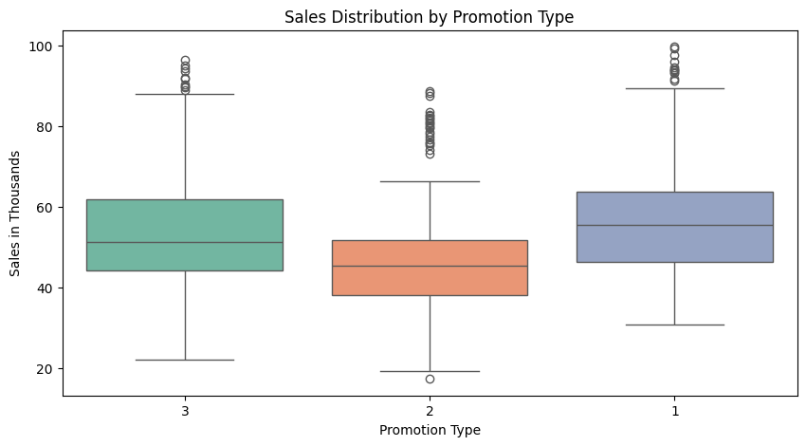
Business Implications:
Promotion 1 is the most effective overall, yielding the highest median sales and some extreme high performers.
Promotion 3 is also strong, but with slightly lower median sales.
Promotion 2 underperforms and may need to be reconsidered or modified to be more competitive.

Slide 11
Correlation Analysis
Sales vs. Market Size (-0.45)
There is a moderate negative correlation between sales and market size, meaning that as market size increases, sales tend to decrease.
This could indicate that larger markets face more competition, reducing the impact of promotional campaigns.
Sales vs. Store Age (-0.03)
The correlation between sales and store age is very weak, meaning that older stores do not necessarily perform better or worse than newer stores.
This suggests that sales performance is driven more by promotions and market conditions rather than store age.
Sales vs. Promotion Type
The impact of promotions on sales varies depending on the type of campaign.
The OLS regression results indicate that Promotion 1 is the most effective, while Promotion 2 has a significantly negative effect.
The correlation values confirm that different promotions have distinct influences on sales trends.

Slide 12
5.Sales vs. Week (-0.01)
The time variable (week) shows a negligible correlation with sales, implying that there is no strong upward or downward trend over the four weeks of the experiment.
This means that the effectiveness of marketing campaigns remains relatively stable over time.
6.Market Size vs. Other Factors
Market size is negatively correlated with sales (-0.45), which suggests that promotion effectiveness varies across market sizes.
Market size also shows some correlation with store age (0.16), indicating that older stores might be more prevalent in certain market sizes.

Slide 13
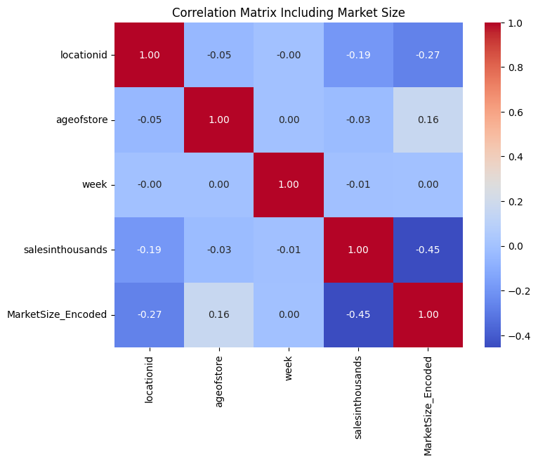
Correlation Analysis

Slide 14
Chi-Square Test of Homogeneity for Market Size Across Promotions
Objective:
To determine whether the distribution of market size (small, medium, or large) is significantly different across the three promotional campaigns.
Null Hypothesis (H₀):
Market size distribution is the same across all promotions.
Alternative Hypothesis (H₁):
Market size distribution differs across promotions.
Results:
Chi-Square Statistic: 4.7539
p-value: 0.3135
Interpretation:
Since p-value (0.3135) > 0.05, we fail to reject the null hypothesis. This means there is no significant difference in market size distribution across the three promotional campaigns.
Implication for Analysis:
Market size is evenly distributed among the promotional groups, meaning that any sales differences observed are likely due to the promotion itself rather than an imbalance in market size.
This ensures that the comparison of promotions remains fair and unbiased, supporting the validity of further statistical tests like ANOVA and OLS regression.

Slide 15
OLS Regression Results
Regression Model Summary:
Dependent Variable: Sales (in thousands).
R² = 0.582 → The model explains 58.2% of the variance in sales.
Adjusted R² = 0.578 → The model remains robust when adjusted for the number of predictors.
F-statistic: 150.9, p < 0.0001 → The model is statistically significant.
Predictor | Coefficient | P-Value | Interpretation
Intercept | 45.33 | 0.000 | Base sales (without promotions).
Promotion 2 | -10.75 | 0.000 | Significantly reduces sales compared to Promotion 1.
Promotion 3 | -1.07 | 0.352 | No significant impact on sales.
Medium Market Size | +2.04 | 0.002 | Positively affects sales.
Large Market Size | +28.68 | 0.000 | Strongly boosts sales.
Small Market Size | +14.60 | 0.000 | Significantly increases sales.
Store Age | +0.07 | 0.320 | No significant effect on sales.

Slide 16
Key Findings from Analysis
Promotion Effectiveness:
Promotion 1 performs best.
Promotion 2 significantly lowers sales.
Promotion 3 has no significant effect.
Market Size Influence:
Larger markets drive higher sales.
Medium and small markets also show a positive effect.
Store Age:
Minimal effect on sales → Older stores do not necessarily perform better.
Regression Insights:
The model explains 58.2% of the variation in sales (R² = 0.582).
Additional factors (seasonality, competitor actions) may improve predictive power.

Slide 17
🛰️ Model Deployment: Sales Prediction Web App
To enable practical use of our analysis, we developed an interactive web application using Streamlit. This app allows users to input store-specific parameters and receive real-time sales predictions.
🔧 Features:
Market Size: Select from Small, Medium, or Large.
Promotion Level: Input promotional effort (1 to 3).
Store Age: Years since the store opened.
Week: Choose the week for which prediction is needed.
🎯 Purpose:
This tool empowers decision-makers to:
Simulate outcomes of different promotional strategies.
Compare campaign effectiveness across varying market conditions.
Make data-driven marketing decisions based on predicted sales.
👉 Technologies Used:
Streamlit for front-end interface
Scikit-learn for model inference
Pandas/Numpy for data processing

Slide 18
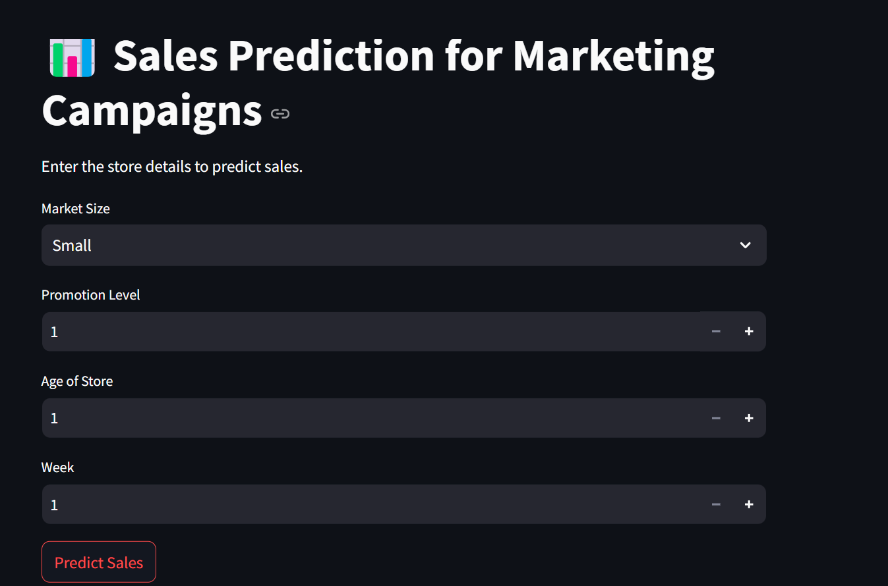
🖼️ Interface Preview:

Slide 19
Conclusion
Promotion 1 is the most effective.
Promotion 2 should be restructured or removed.
Market size plays a significant role in sales performance.
Store age does not influence sales significantly.
Recommendations
Prioritize Promotion 1 in future marketing campaigns.
Revise Promotion 2 to improve its impact.
Focus on large and medium markets for the highest return.
Further explore additional factors (e.g., pricing, competition).
19

Slide 20
Thank you

